Slide 1

Car Brand Classification Using Deep Convolutional Neural Networks. Course Title : pattern Recognition lab Course Code : CSE 460

Slide 2
Submitted By:
Paromita Saha (2104010202333)
Sumaiya Nasrin (2104010202336)

Slide 3

AGENDA
Workflow Overview:
Introduction
Dataset Description
Data Preprocessing
Visualization
Model training and evaluation
Result
Testing on unseen image
Conclusion

Slide 4

Introduction: The project aims to create an automated car brand recognition system using transfer learning techniques with DenseNET201 and mobilenetv2. The system uses deep learning architectures, that have been fine-tuned on a labeled dataset of car images.

Slide 5

Dataset Description
Source: Car image dataset from Kaggle. Structure: Train set: 80% Test set: 20% Each folder represents a car brand (e.g., Audi, BMW, Tesla). Image size: 224×224 pixels. Format: JPEG images.

Slide 6
Data Preprocessing
Data Preprocessing:
Data Cleaning:
Data cleaning involved finding and removing corrupted or unreadable image files from the dataset. This step ensured that only valid and correctly formatted images were used for model training.
Resizing: All images were resized to a fixed dimension of 224×224 pixels to maintain consistency and meet the input requirements ofpre-trained CNN models like DenseNet201 and EfficientNetB0
Normalization:
Normalization scaled pixel values from their original range of 0–255 to a range between 0 and 1.

Slide 8
Augmentation: To make the model more robust and avoid overfitting, data augmentation techniques were applied using the ImageDataGenerator function.

Slide 9
Visualization We displays sample images from each car brand class in the dataset to visualize classvariety. This helps in quickly checking the dataset’s diversity, image quality, and consistency across different car brand classes.

Slide 10
Model training and evaluation
DENSENET201 MODEL:
DenseNet201 is a deep convolutional neural network with 201 layers, belonging to the DenseNet family. It connects each layer to all previous layers, allowing efficient feature reuse and stronger gradient flow.

Slide 11
Model Training
The training accuracy increased from 33% to 91%, while the training loss decreased from 1.83 to 0.35, indicating the model was learning effectively. Similarly, validation accuracy improved from 65% to 91%, and validation loss decreased from 1.14 to 0.33.

Slide 12
TEST SET:
It achieved a test accuracy of 91.14%, meaning it correctly classified over 91% of the car images, and a test loss of 0.3272

Slide 13
MobileNetV2
MobileNetV2 is a lightweight convolutional neural network designed for efficient mobile and embedded vision applications.

Slide 14
Model Training
Training accuracy increased from 35% to 88%, and training loss decreased from 1.77 to 0.35, indicating effective learning. Validation accuracy rose from 67% to 87%, while validation loss decreased from 1.03 to 0.38.

Slide 15
TEST SET
It achieved a test accuracy of 86.96%, meaning it correctly classified nearly 87% of the car images, and a test loss of 0.3822

Slide 16
Results:
DENSNET201
ACCURACY & LOSS CURVE: These plots visualize the training progress of the DenseNet201 model over 10 epochs. The accuracy plot shows both training and validation accuracy steadily increasing, indicating that the model is learning effectively.

Slide 17
Confusion Matrix:
These metrics provide a clear insight into the model’s strengths and any misclassifications among the classes.

Slide 18
Classification report:
The classification report provides a detailed evaluation of how well the DenseNet201 model predicts each car brand.

Slide 19
ROC Curve:
It first predicts class probabilities (y score) for all test images using the trained DenseNet201 model

Slide 20
MOBILENETV2:
ACCURACY & LOSS CURVE:
the graphs confirm that MobileNetV2 converged well, achieving good performance on both training and validation datasets

Slide 21
Confusion Matrix:
It first predicts class probabilities for all test images and converts them to discrete class labels.

Slide 22
Classification report:
The classification report shows that the MobileNetV2 model performed well on most car brand classes, with an overall accuracy of 87%.

Slide 23
ROC Curve:
The true class labels are first binarized to a one-hot format to allow computation of ROC curves for each car brand.

Slide 24
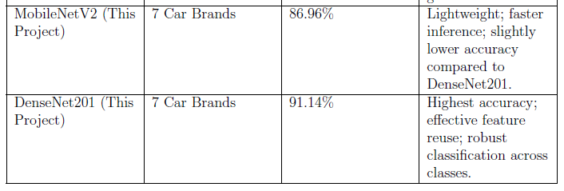
Comparison Table:
classifies more car images. DenseNet201 achieved a test accuracy of 91.14%, higher than MobileNetV2’s 86.96%,meaning it correctly

Slide 25
Future improvements to the project could focus on expanding the dataset to include more car brands and different model variations for better diversity and robustness.
Future work

Slide 26
CONCLUSION
this project highlights the practical challenges of multi-class image classification and showcases the importance of model selection, evaluation, and regularization in deep learning pipelines.

Slide 27

THANK YOU

